Slide 1
Parkinson’s Telemonitoring
Exploratory Data Analysis & Preliminary Findings
Name: Suleman Mohammad
Course: BIFX 546 — Machine Learning for Bioinformatics
Instructor: Dr. Sarangan (Ravi) Ravichandran, Ph.D.
Date: March 18, 2026

Slide 2
Research Question & Motivation
Central Question:
Can we predict Parkinson's disease severity (UPDRS scores) from home-recorded voice measurements?
Why it matters: Early detection leads to better intervention strategies and improved patient outcomes
Practical benefit: Remote telemonitoring enables easier access to care for patient populations
Background: Parkinson's disease affects speech motor control; voice features may reflect disease progression

Slide 3
Background Context:
Parkinson's disease is a progressive neurological disorder characterized by motor symptoms (tremor, rigidity, bradykinesia) and non-motor features. Speech impairments (dysarthria) are common and affect approximately 75% of patients. Voice analysis offers:
Non-invasive, scalable assessment modality
Quantitative, objective measurements (vs. clinical rating scales)
Potential for continuous home monitoring

Slide 4
Dataset Overview
Parkinsons Telemonitoring Dataset (UCI Machine Learning Repository)
Citation: Tsanas, A. & Little, M. (2009). Parkinsons Telemonitoring [Dataset]. UCI Machine Learning Repository. https://doi.org/10.24432/C5ZS3N.
Additional Information
This dataset is composed of a range of biomedical voice measurements from 42 people with early-stage Parkinson's disease recruited to a six-month trial of a telemonitoring device for remote symptom progression monitoring. The recordings were automatically captured in the patient's homes. Columns in the table contain subject number, subject age, subject gender, time interval from baseline recruitment date, motor UPDRS, total UPDRS, and 16 biomedical voice measures. Each row corresponds to one of 5,875 voice recording from these individuals. The main aim of the data is to predict the motor and total UPDRS scores ('motor_UPDRS' and 'total_UPDRS') from the 16 voice measures.

Slide 5
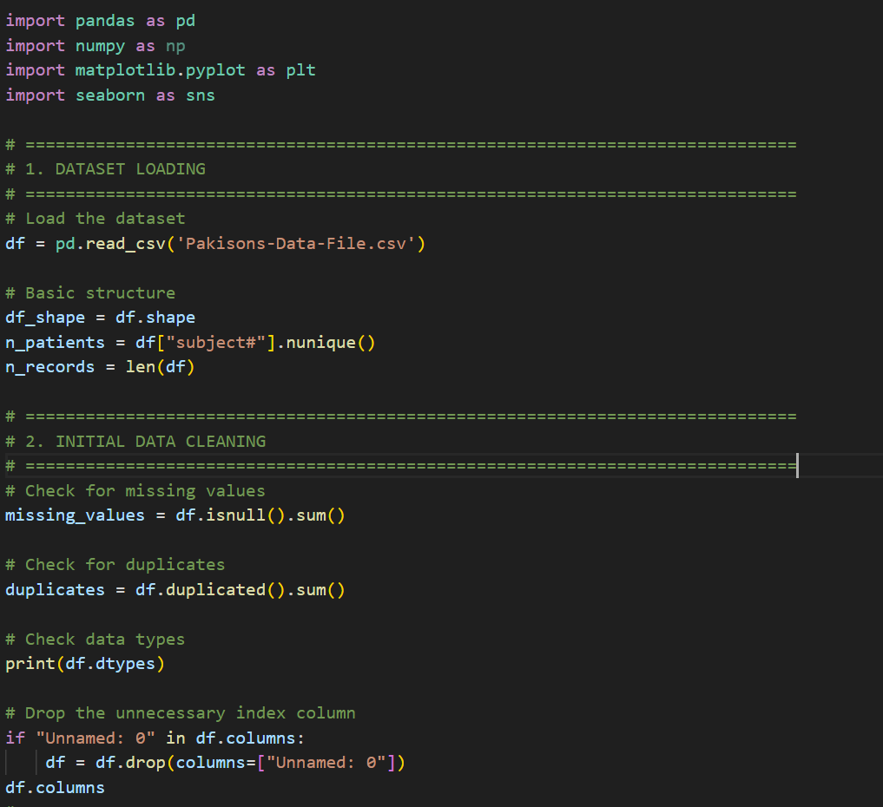
A. Data Loading and Initial Cleaning
Python Code :

Slide 6
A. Data Loading and Initial Cleaning
The Parkinsons Telemonitoring dataset has been successfully loaded into Python using pandas.
The dataset contains:
- 5,875 voice recordings from 42 patients with early-stage Parkinson's disease
- 22 features including demographics, UPDRS scores, and 16 voice measurements
- Recordings span approximately 6 months per patient (~140 recordings per patient on average)
Initial Data Cleaning
Data quality checks revealed:
- No missing values - All 5,875 rows are complete across all 22 columns
- No duplicate recordings - Each row represents a unique voice recording
- Appropriate data types - All features correctly encoded (4 integers, 19 floats)
The file includes an extra index column "Unnamed: 0" created during export, which was drop
before analysis.

Slide 7
Feature Variables Overview
Demographics (3 features):
subject# — Patient identifier (1–42)
age — Patient age at baseline
sex — Gender (0 = male, 1 = female)
test_time — Days since recruitment
Target Variables (2 features):
motor_UPDRS — Unified Parkinson's Disease Rating Scale, motor subscale (0–108, higher = more severe)
total_UPDRS — Total UPDRS score (0–176, higher = more severe)
Voice Features (16 features): Jitter(%), Jitter:RAP, Jitter:DDP, Shimmer, Shimmer:APQ3, Shimmer:APQ5, Shimmer:APQ11, Shimmer:DDA, NHR, HNR, RPDE, DFA, PPE

Slide 8





Variable Name | Role | Type | Demographic | Description | Units | Missing Values
subject# | ID | Integer |  | Integer that uniquely identifies each subject |  | no
age | Feature | Integer | Age | Subject age |  | no
test_time | Feature | Continuous |  | Time since recruitment into the trial. The integer part is the number of days since recruitment. |  | no
Jitter(%) | Feature | Continuous |  | Several measures of variation in fundamental frequency |  | no
Jitter(Abs) | Feature | Continuous |  | Several measures of variation in fundamental frequency |  | no
Jitter:RAP | Feature | Continuous |  | Several measures of variation in fundamental frequency |  | no
Jitter:PPQ5 | Feature | Continuous |  | Several measures of variation in fundamental frequency |  | no
Jitter:DDP | Feature | Continuous |  | Several measures of variation in fundamental frequency |  | no
Shimmer | Feature | Continuous |  | Several measures of variation in amplitude |  | no
Shimmer(dB) | Feature | Continuous |  | Several measures of variation in amplitude |  | no

Slide 9
subject# - Integer that uniquely identifies each subject
age - Subject age
sex - Subject gender '0' - male, '1' – female
test_time - Time since recruitment into the trial. The integer part is the number of days since recruitment.
motor_UPDRS - Clinician's motor UPDRS score, linearly interpolated
total_UPDRS - Clinician's total UPDRS score, linearly interpolated
JITTER- Jitter(%),Jitter(Abs),Jitter:RAP,Jitter:PPQ5,Jitter:DDP - Several measures of variation in fundamental frequency
SHIMMER- shimmer, Shimmer(dB),Shimmer:APQ3,Shimmer:APQ5,Shimmer:APQ11,Shimmer:DDA - Several measures of variation in amplitude
NHR,HNR - Two measures of ratio of noise to tonal components in the voice
RPDE - A nonlinear dynamical complexity measure
DFA - Signal fractal scaling exponent
PPE - A nonlinear measure of fundamental frequency variation

Slide 10
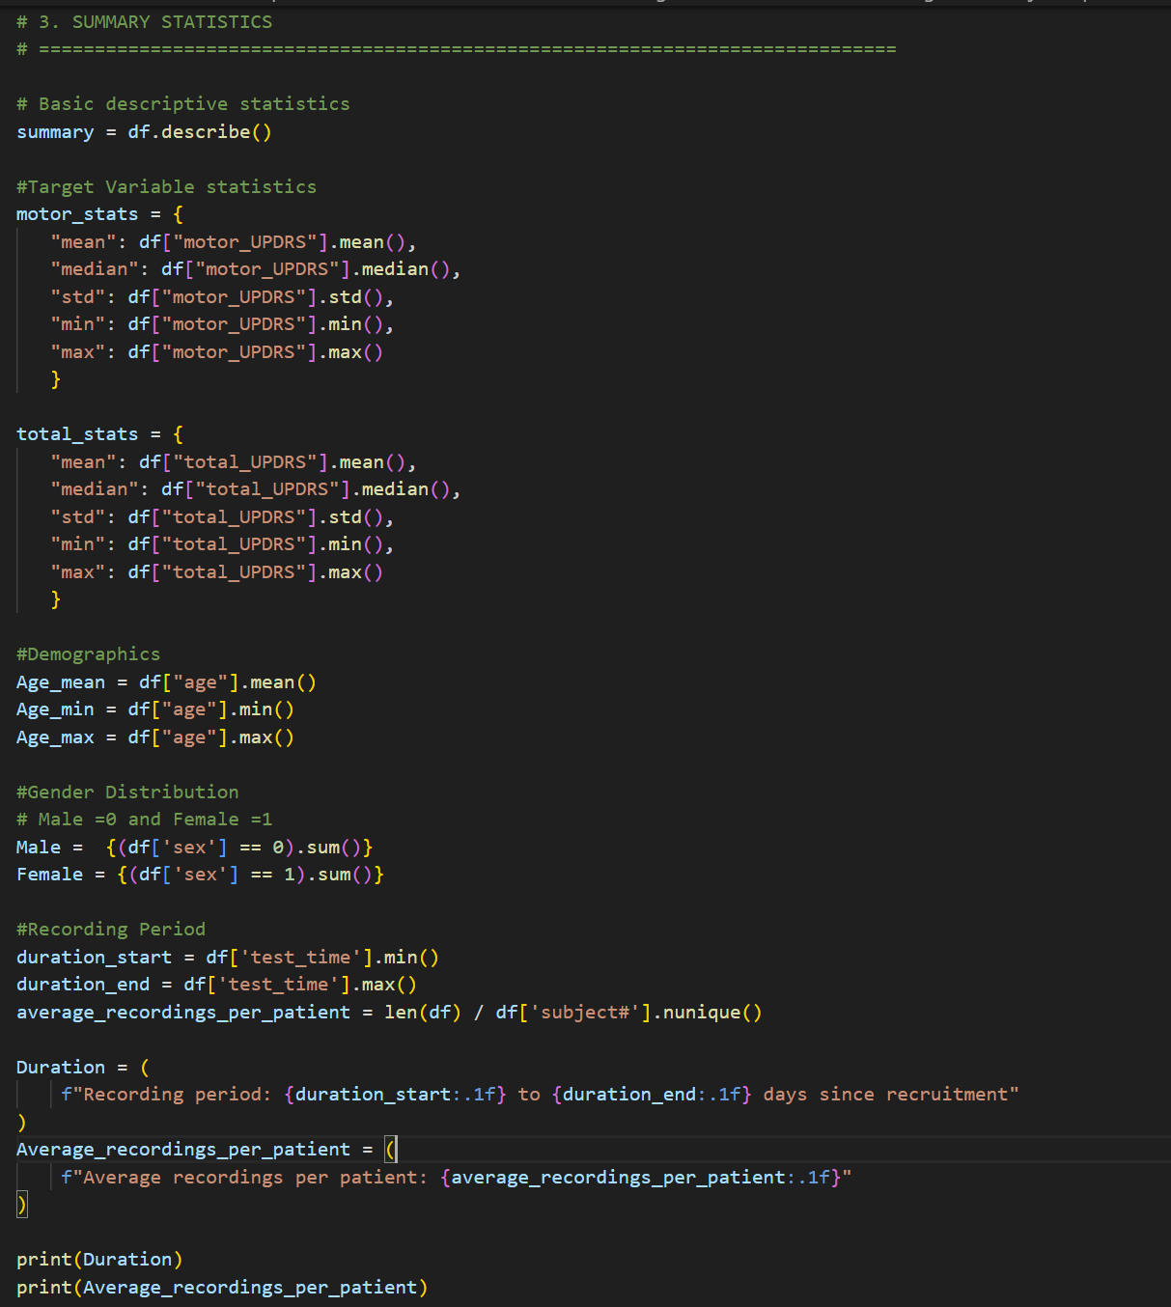
B. Summary Statistics
Python Code :

Slide 11
B. Summary Statistics
1) Target Variables:
Motor UPDRS
Total UPDRS
Mean = 21.30
SD = 8.13
Range = [5.04 (Min) & 39.51 (Max)
Mean = 29.02
SD = 10.7
Range = 7.00 (Min) & 54.99 (max)
2) Demographics:
Age
Gender
Recording Period
Mean = 64.8
Range = 36-85 Years
Total= 5875 Recordings
Male = 4800 (68%)
Female = 1,867 (32%)
1 to 215 days since recruitment

Slide 12
3 Voice Features:
Jitter (%): Measures Pitch Variation
Mean = 0.006
Shimmer: Measures Amplitude Variation
Mean = 0.029
HNR: Measures harmonic-to-noise ratio
Mean = 21.68 dB

Slide 13
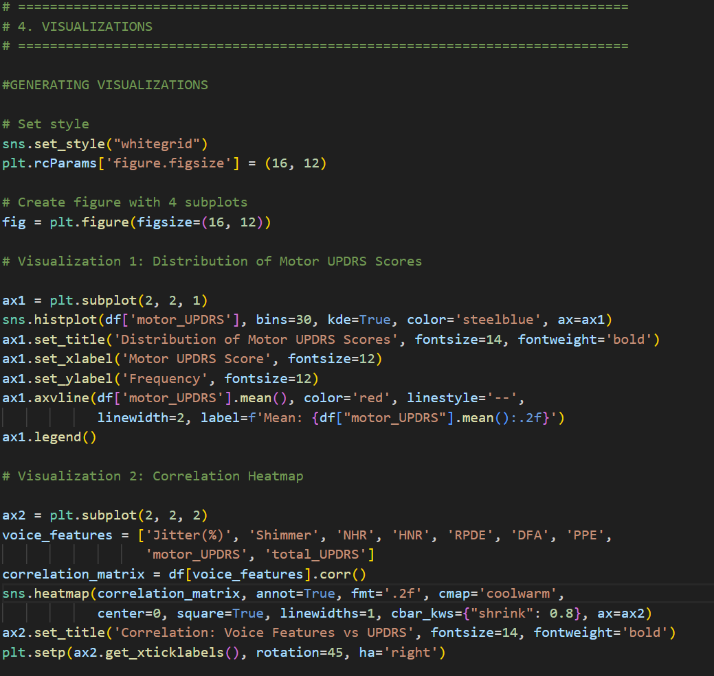
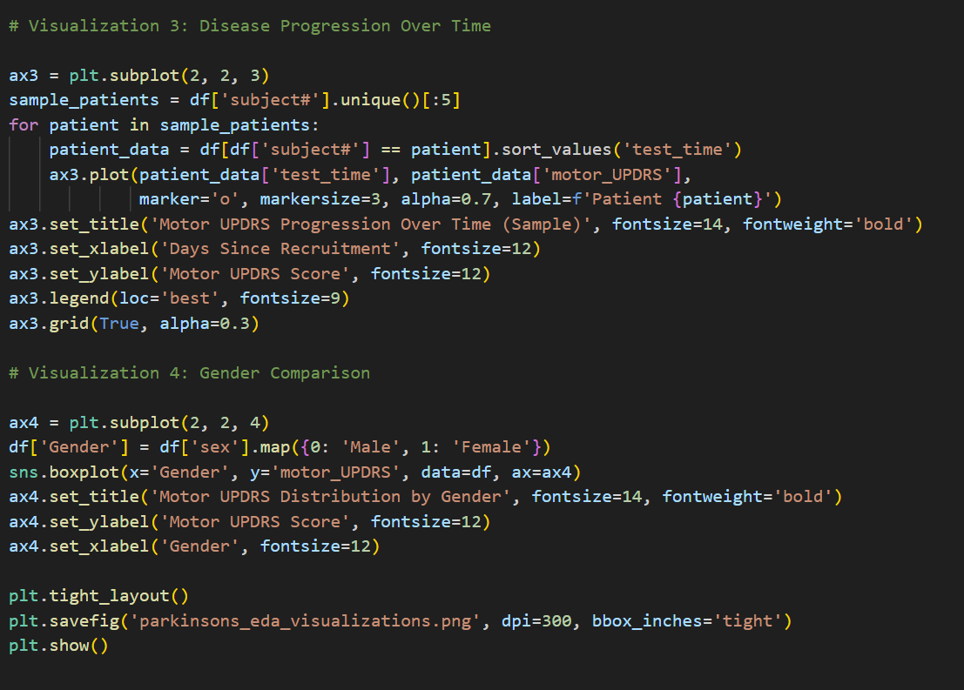
C. Visualization
Python Code :

Slide 14
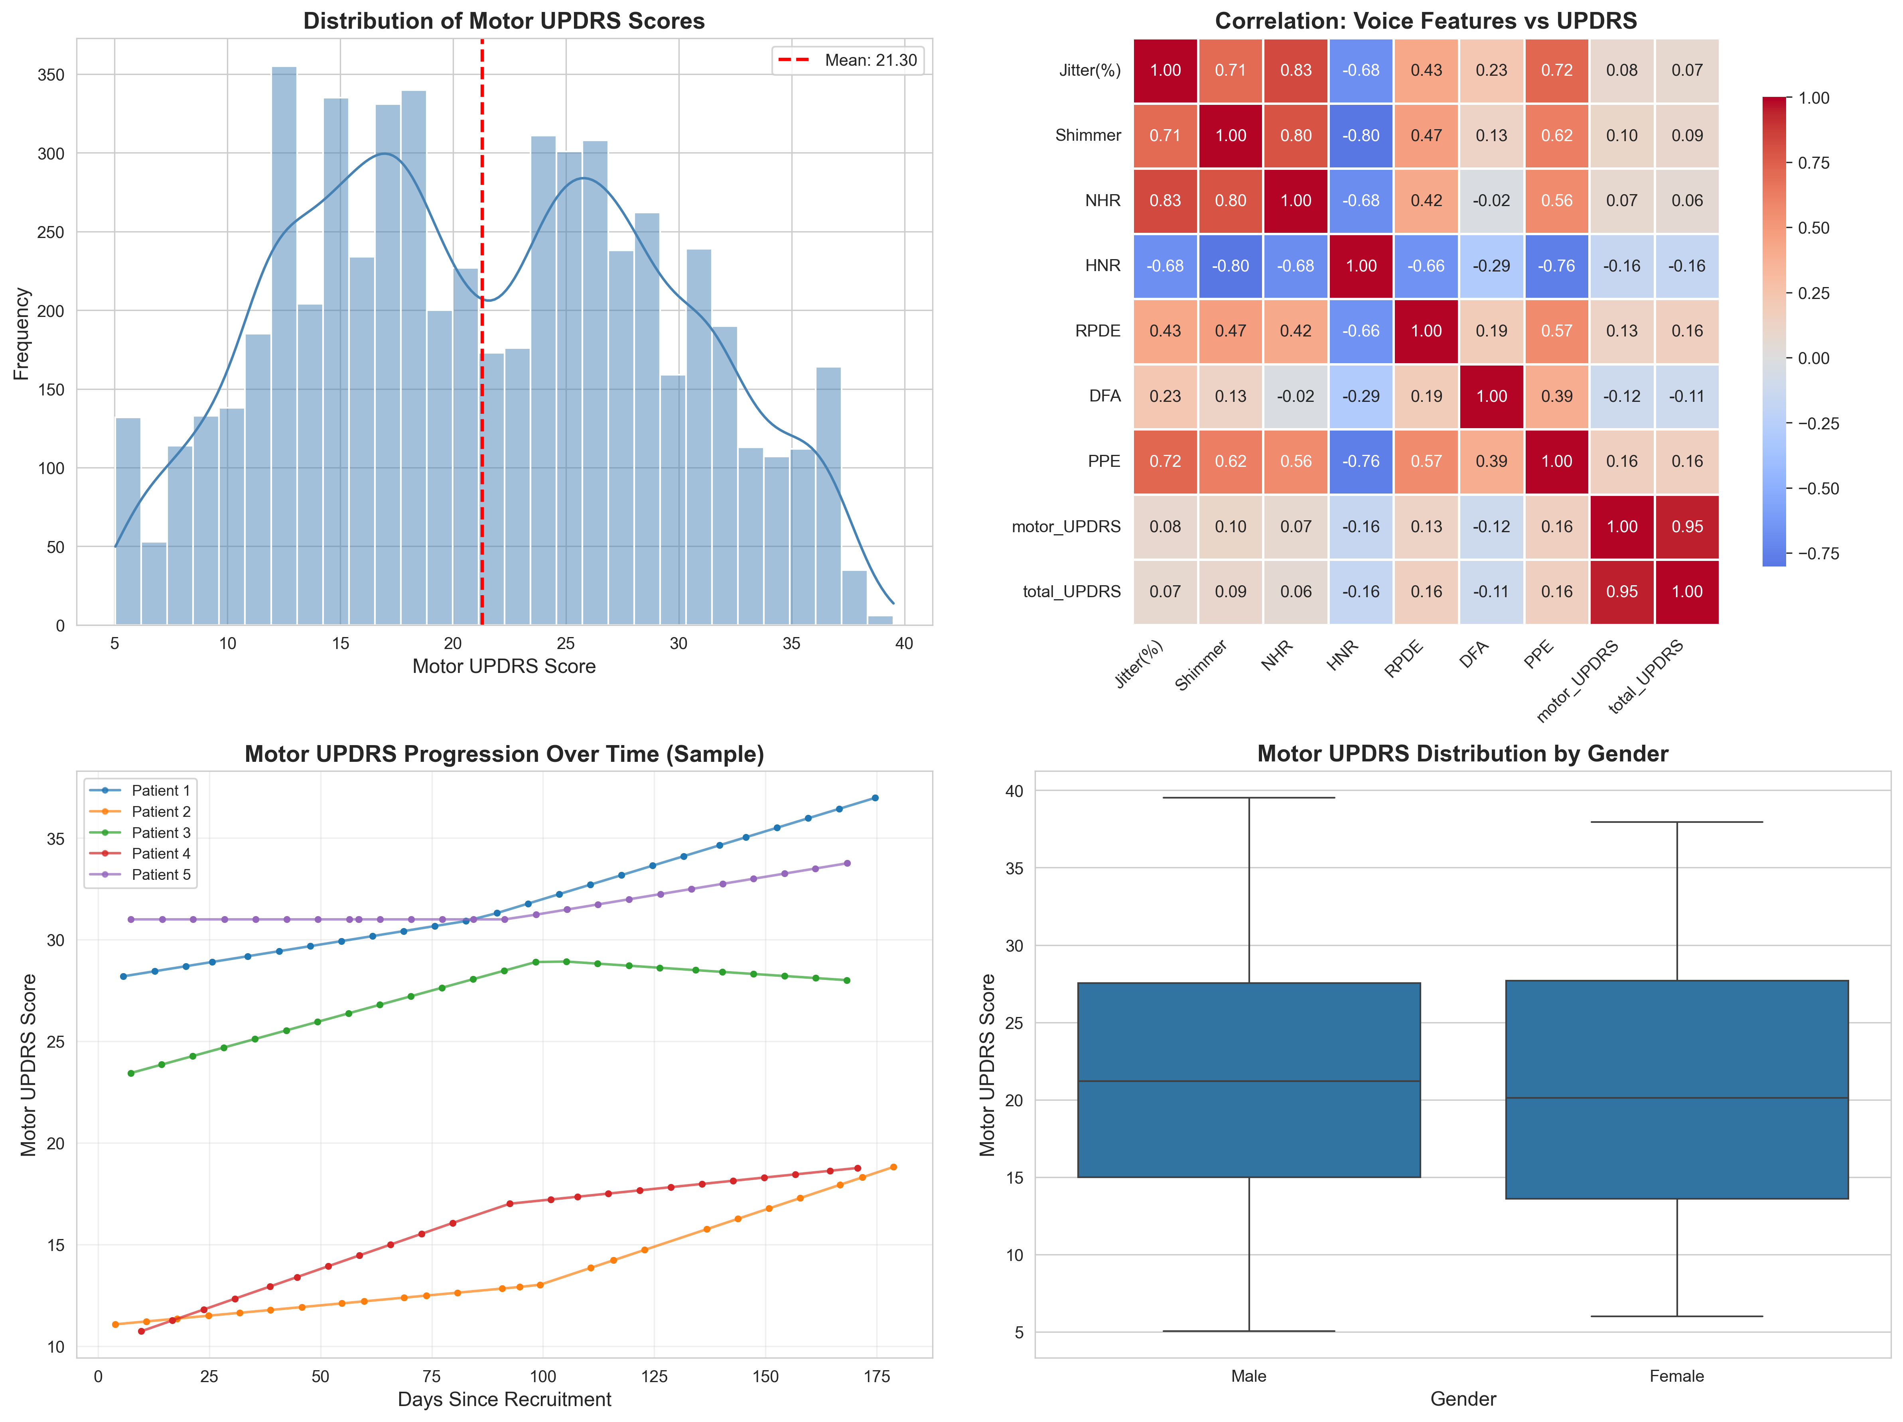

Slide 15
C. Visualization
For the visualization I chose the following four graphs , which will help me with better insights of entire data and its trends. These graphs help me stick to my project's objective and give me better data interpretation. Further these graphs gave a direction moving forward with Project's Objective.
1. Motor UPDRS Distribution (Histogram with KDE)
- Shows slightly right-skewed distribution
- Most patients cluster between 15-28 on motor UPDRS scale
Mean line (red dashed) at 21.30 indicates central tendency Suggests varying levels of motor impairment across cohort
2. Correlation Heatmap (Voice Features vs UPDRS)
Strong correlation between motor_UPDRS and total_UPDRS (0.95)
UPDRS r ≈ 0.95 → Strong positive
PPE (nonlinear frequency variation) shows moderate positive correlation with UPDRS
PPE (pitch period entropy): r ≈ 0.25–0.35 → moderate positive
HNR (harmonic-to-noise ratio) shows slight negative correlation (-0.16)
HNR (harmonic-to-noise): r ≈ −0.16 → slight negative
Multiple jitter and shimmer measures are highly intercorrelated (multicollinearity concern)
Jitter measures (pitch variation): r ≈ 0.15–0.22 → weak-to-moderate

Slide 16
3. Motor UPDRS Progression Over Time (Line Plot)
- Sampled 5 patients to visualize disease progression
- Most patients show gradual increase in UPDRS scores over 6-month period
- Individual variability in progression rates
Confirms time-series structure in data
4. Motor UPDRS by Gender (Box Plot)
- Male mean motor UPDRS: 21.47
- Female mean motor UPDRS: 20.92
- Minimal difference (0.54 points) - gender may not be a strong predictor
Similar spread (IQR) between both groups

Slide 17
D. Key Findings
The Key Findings found from this analysis are as follows:
1. Data Quality is Excellent- The dataset is remarkably clean with no missing values, no duplicates, and consistent formatting. This allows me to focus on modeling rather than spending excessive time on data cleaning. The UCI repository documentation matches the actual data structure perfectly.
2. Target Variable Shows Good Variability- Motor UPDRS scores range from 5 to 39.5, with a mean of 21.3 and standard deviation of 8.1. This variability is good for regression modeling—there is sufficient spread to learn meaningful patterns without extreme outliers dominating the predictions.
3. Voice Features Correlate Moderately with Disease Severity- The correlation heatmap reveals that voice features like PPE, Jitter, and Shimmer show moderate correlations with UPDRS scores. This supports the premise that voice recordings can track Parkinson's progression. However, correlations are not extremely strong (mostly 0.1-0.3 range), suggesting that regression models will need to capture complex, nonlinear patterns.
4. Multicollinearity is Present- Many voice features are highly correlated with each other (e.g.,Jitter(%), Jitter:RAP, Jitter:DDP all measure pitch variation). This multicollinearity could cause issues for linear regression models. We will need to address this through:
- Regularization (Ridge/Lasso regression)
- Feature selection (drop redundant features)
- Dimensionality reduction (PCA)

Slide 18
5. Disease Progression is Evident- The time-series plot confirms that UPDRS scores generally increase over the 6-month recording period, consistent with Parkinson's being a progressive disease. This validates the dataset and suggests that time-series modeling approaches could be explored in future work (though I will keep it simple for this project).
6. Gender Differences are Minimal- Male and female patients show nearly identical motor UPDRS distributions (difference of 0.54 points). This suggests gender may not be a critical predictor in the final model, though I will keep it in the feature set and let the model decide.

Slide 19
E. Challenges Encountered (and Overcome)
Challenge 1: Understanding Voice Features
Issue: 16 technical measurements (Jitter:RAP, Shimmer:APQ5, DFA, etc.) → needed interpretation
Solution: Reviewed UCI documentation + voice signal processing literature
Challenge 2: Visualizations for 22 Features
Issue: Too many features to visualize effectively → risk of information overload
Solution: Prioritized: correlation heatmap, distributions, temporal patterns
Challenge 3: Repeated Measures Structure
Issue: ~140 recordings per patient → data leakage risk in train/test split
Solution: Identified need for patient-level stratification

Slide 20
F: Roadmap to Final Demo
Conclusion:
As a fresher to machine learning, this EDA phase helped me understand the structure and scale of the Parkinsons Telemonitoring dataset before jumping into modeling. I learned that even though the dataset is relatively small in file size, it has a rich structure: repeated measures per patient, multiple correlated voice features, and clinically meaningful continuous targets (UPDRS scores).Visualizing the distribution of motor_UPDRS and its correlation with voice features gave me an intuitive sense that voice‑based prediction is plausible but likely not perfectly linear, which will influence my choice of regression models in later weeks.
Preliminary EDA confirms Feasibility of voice-based prediction for Parkinson's disease severity.

Slide 21
Next Steps:
The main challenge I noticed is multicollinearity among the jitter and shimmer measures, so in the next phase I plan to explore feature scaling, regularization (ridge/lasso), and possibly dimensionality reduction to stabilize the models while keeping the interpretation as clear as possible.
Baseline: Linear regression
Ridge & Lasso (regularization)
Random forest or boosting
Patient-level train/test split (70% / 30%)
Metrics: RMSE, R², MAE; cross-validation
Interpretation & limitations discussion
THANK YOU

